Slide 1
Starbucks Application Team Project for CMPE 202: Software Systems Engineering(Spring 2019)
Members:
Arkil Thakkar(013825292)
Pranjal Sharma(013831688)
Rachit Saxena(012469626)
Shravani Pande(013849264)
Nehal Sharma(013849290)

Slide 2
Components Implemented
Individual components:
Authentication API: Implemented by Pranjal
Add Card API: Implemented by Rachit
Manage Order API: Implemented by Shravani
Make Payment API: Implemented by Nehal
Remove Card API: Implemented by Arkil
Tasks completed for Extra Credit:
Deploy API to AWS in an Auto Scaled EC2 Cluster with Load Balancer
Implement Web "Front-End" Deployed to Heroku for Starbucks Payment Card management

Slide 3
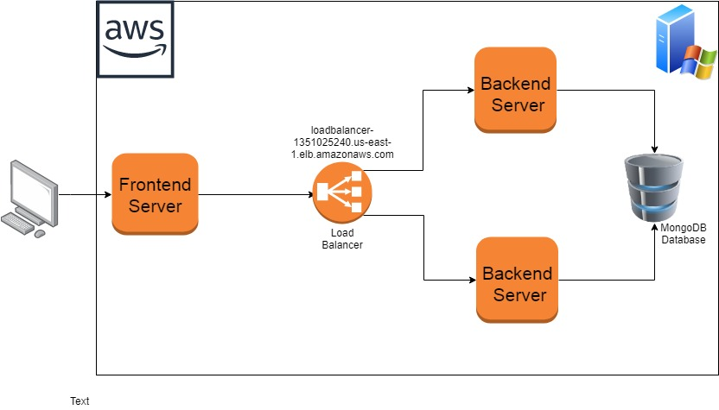
System Architecture

Slide 4
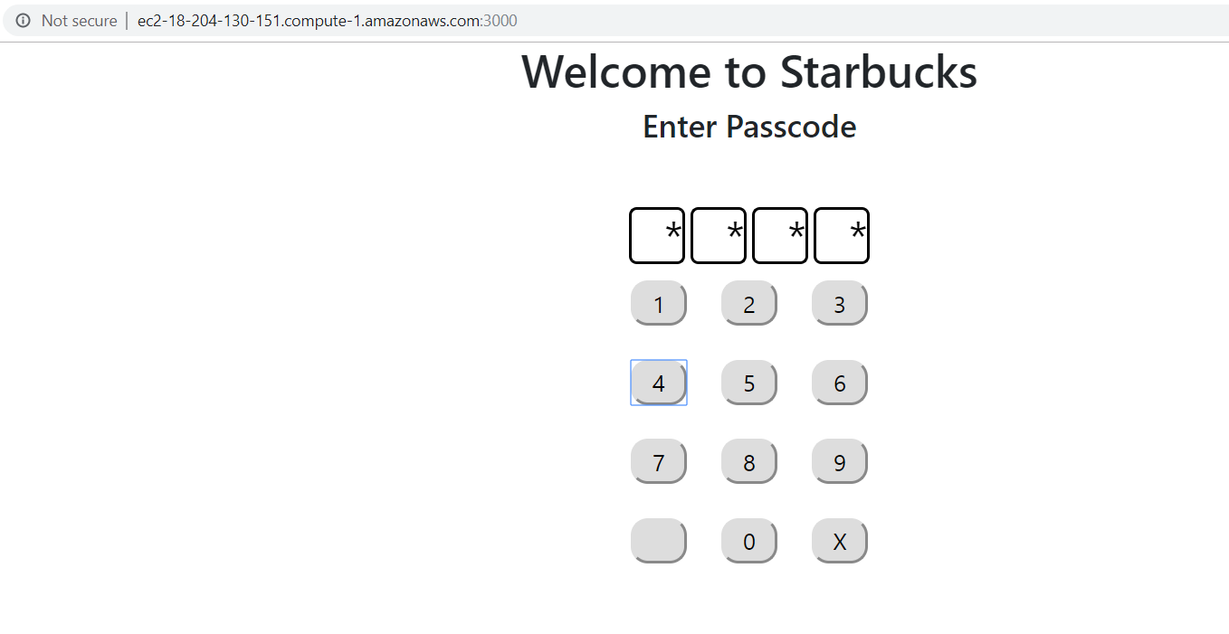
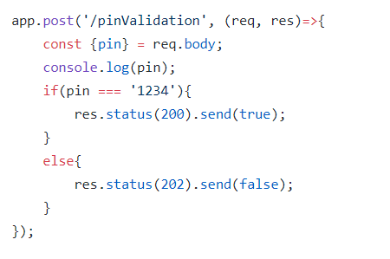
Authentication API

Slide 5
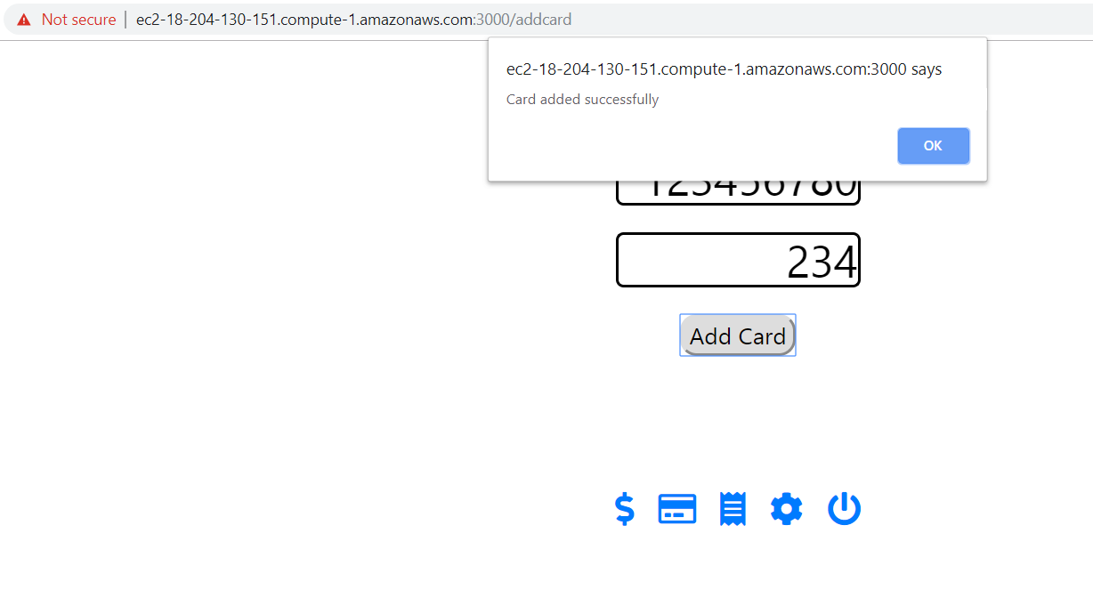
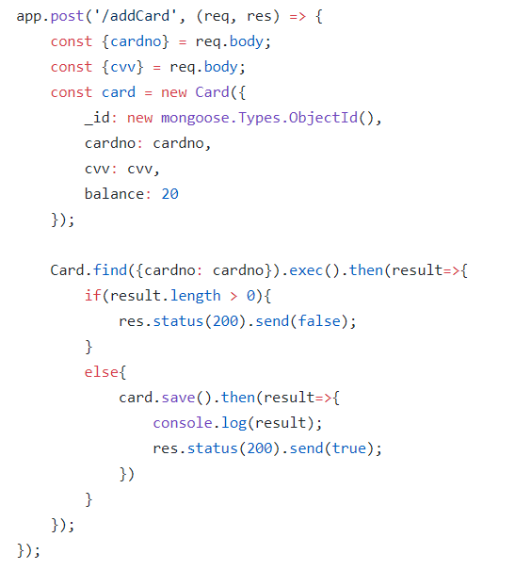
Add Card API

Slide 6
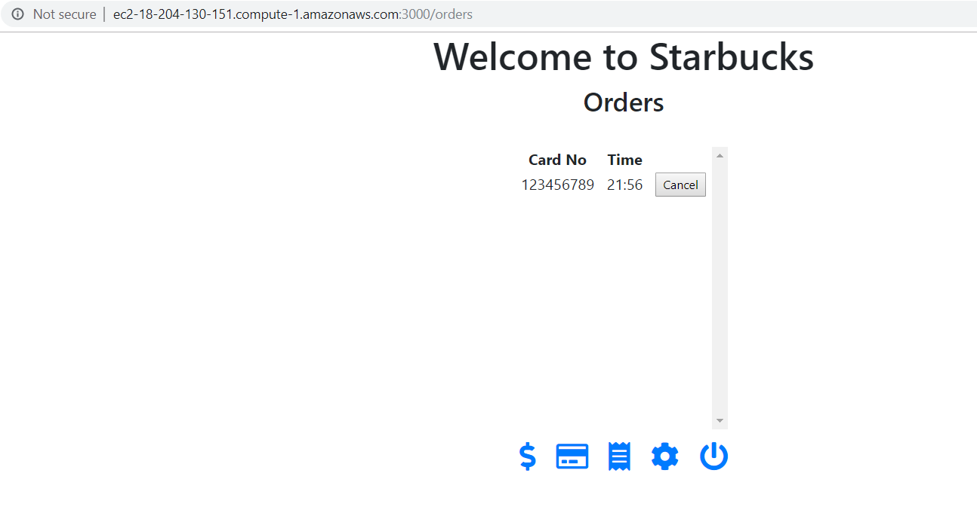
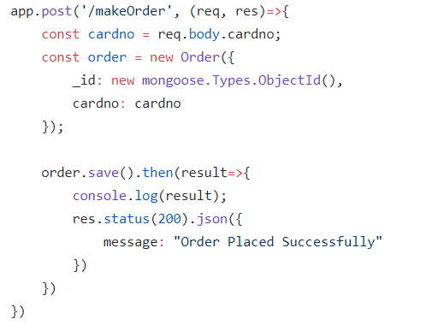
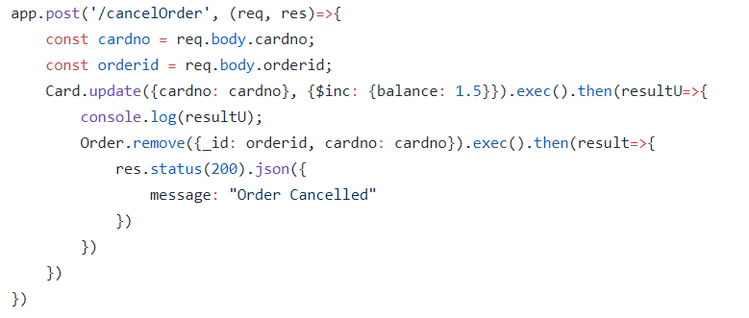
Manage Order API

Slide 7
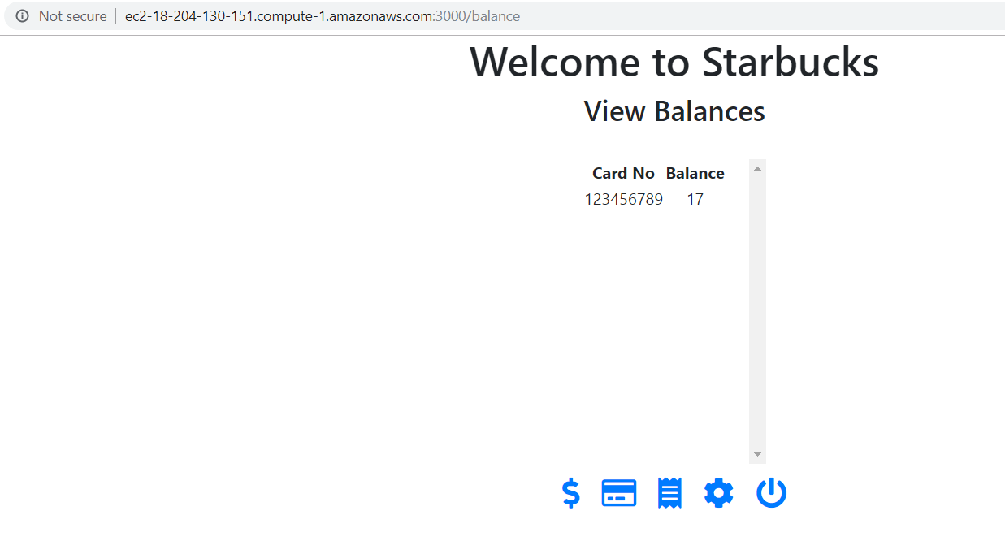
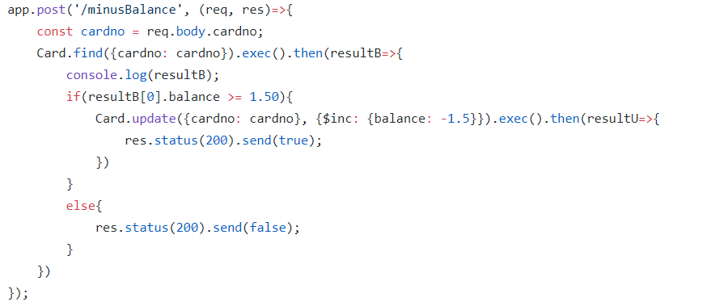
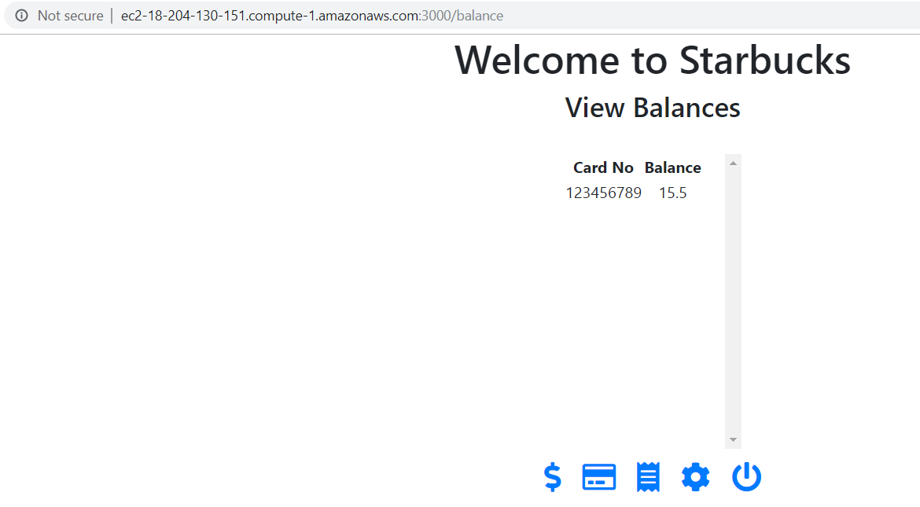
Make Payments API

Slide 8
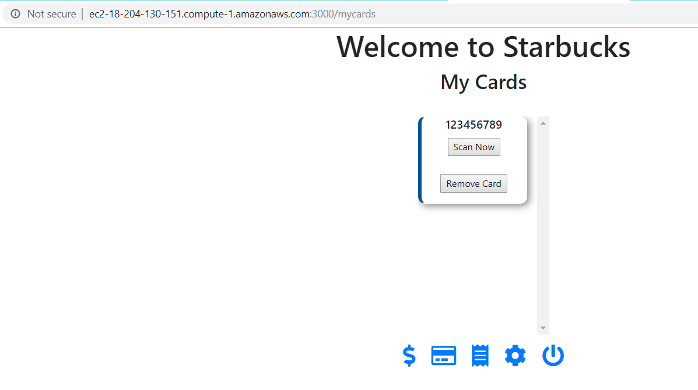
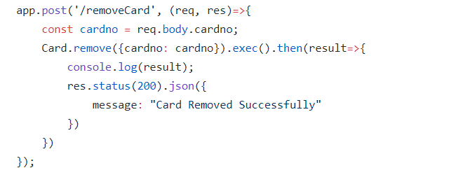
Remove Card API

Slide 9
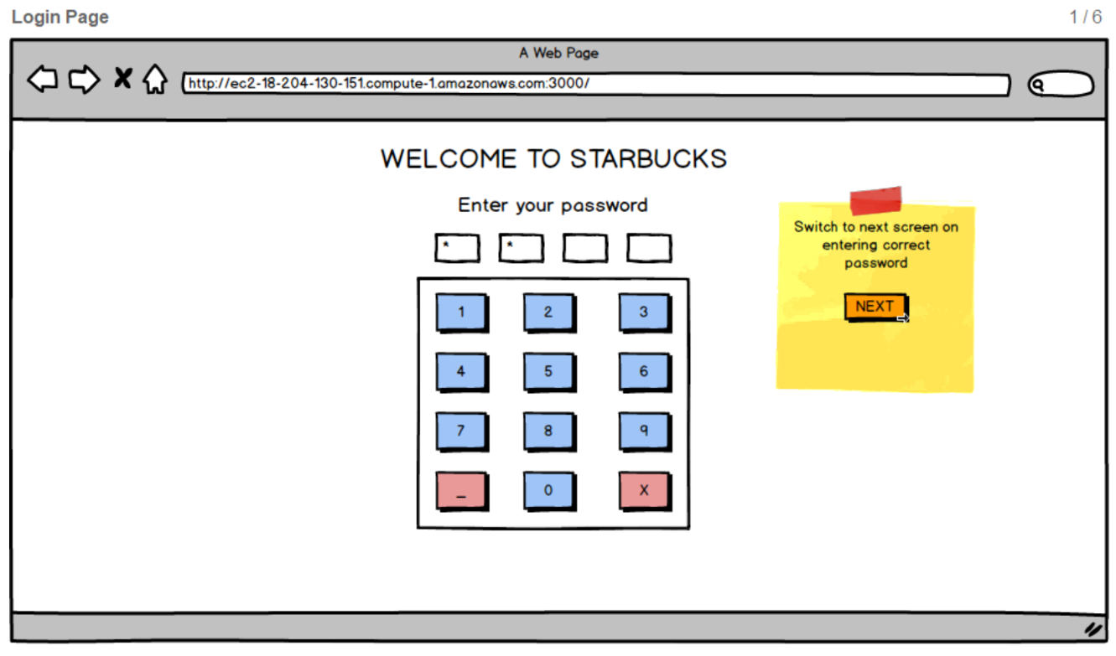
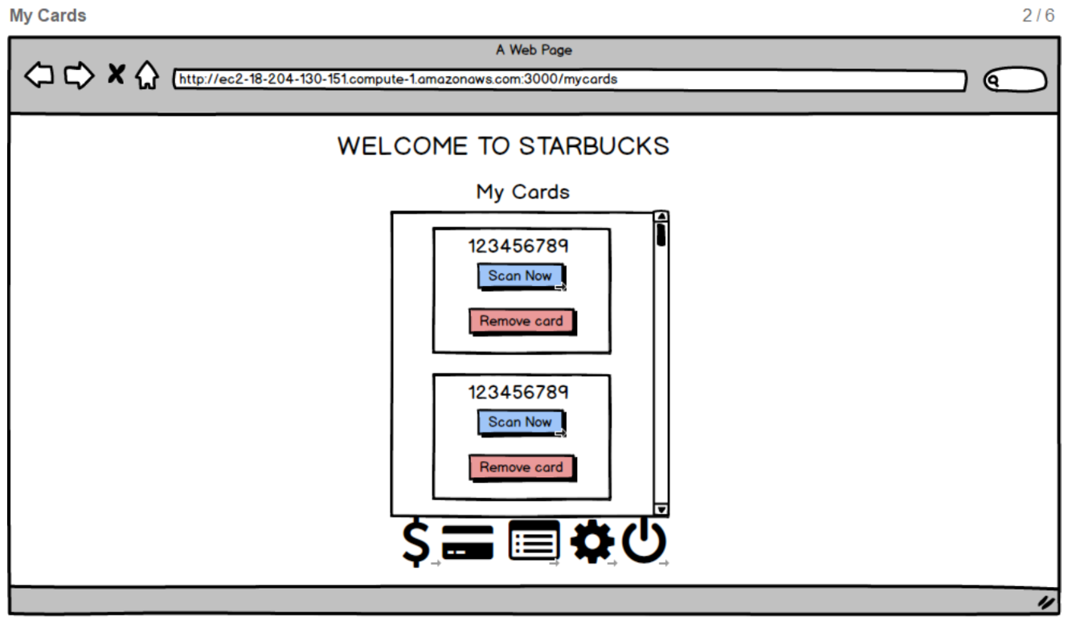
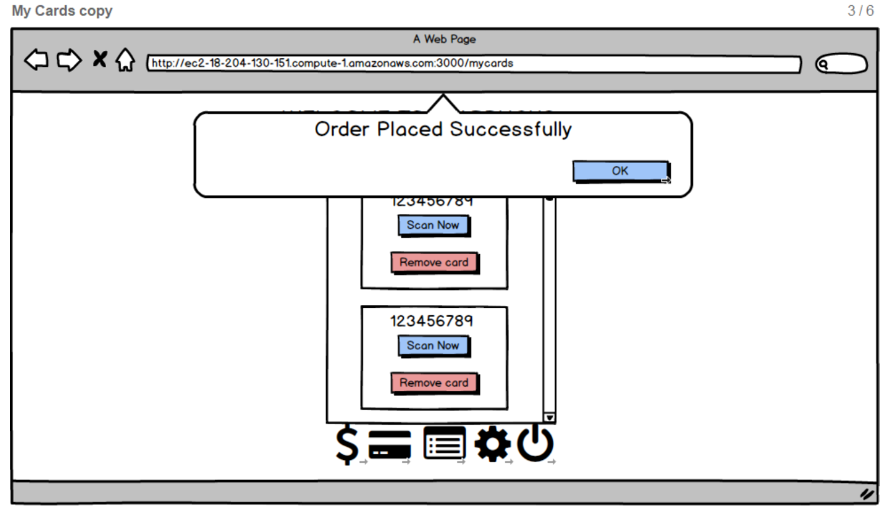
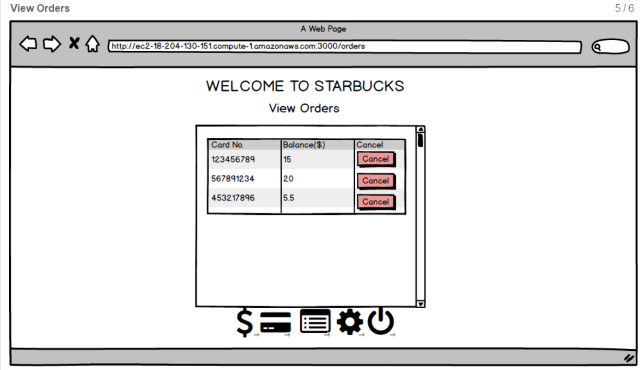
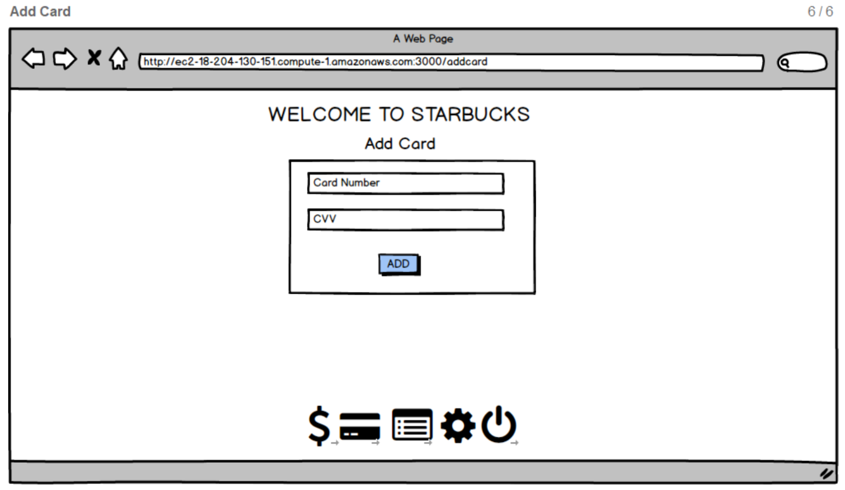
UI Wireframes

Slide 10
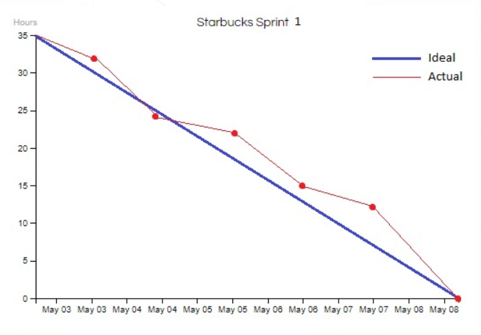
Burndown Chart

Slide 11
Thank You!

